Slide 1
BIKE SHARING DEMAND ANALYSIS
Objective:
Analyse bike rental trends.
Understand the effect of weather, holidays and time.
Create an interactive Excel dashboard.
GUIDANCE: NEXTHIKES IT SOLUTIONS
Presented BY: MANSHI AHUJA

Slide 2
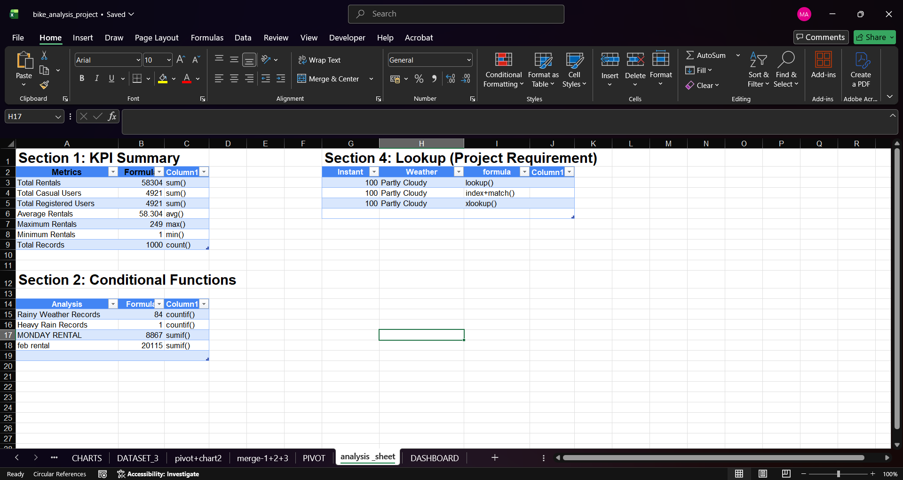
Dataset, Data Cleaning & Analysis
Dataset
611 Records
16 Columns
Data Cleaning
CLEANED DATASET 1 ,2 AND 3
Merged 3 datasets using Power Query.
Removed duplicates.
Checked missing values.
Renamed columns.
Excel Functions Used
SUM(),AVERAGE(),MIN
COUNT()
SUMIF
COUNTIF
AVERAGE
VLOOKUP
XLOOKUP
INDEX + MATCH
Collect Data → Merge Data → Clean Data → Transform Data → Apply Excel Functions → Create Analysis Sheet → Create Pivot Tables → Create Pivot Charts → Build Dashboard → Add Slicers → Generate Insights

Slide 3
HOURLY DEMAND ANALYSIS

Slide 4
MONTHLY RENTAL TREND
(Observations)
January recorded the highest number of bike rentals.
February recorded comparatively lower rentals.
This indicates that customer demand was higher in January during the available dataset period.
Conclusion:
Monthly analysis helps identify demand patterns and supports better business planning.

Slide 5
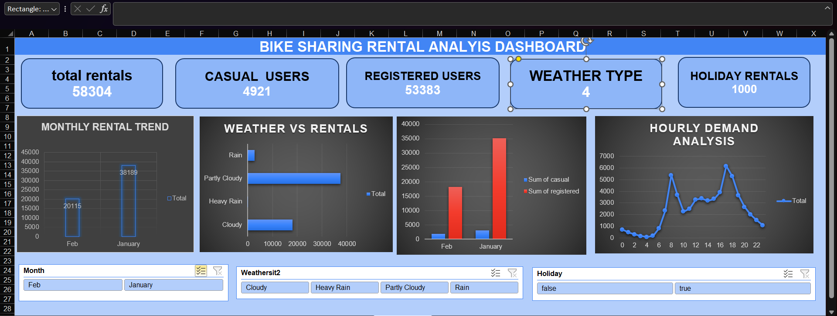
DASHBOARD

Slide 6
STAR ANALYSIS
Situation (S)
I was provided with a bike sharing rental dataset containing information such as date, season, weather, holiday, temperature, casual users, registered users, and total rentals. The data was distributed across three separate datasets and required preprocessing before analysis.
Task (T)
My objective was to:
Clean and merge the datasets.
Analyse rental trends and customer behaviour.
Create an interactive Excel dashboard.
Identify the impact of weather, holidays, and time on bike rentals.
Action (A)
Merged three datasets using Power Query.
Performed data cleaning by checking missing values and duplicates.
Applied Excel functions such as SUMIF, COUNTIF, VLOOKUP, XLOOKUP, and INDEX + MATCH.
Created Pivot Tables and Pivot Charts for data analysis.
Designed an interactive dashboard with KPI Cards, Charts, and Slicers.
Result (R)
January recorded higher rentals than February
Partly Cloudy weather recorded the highest rentals.
Registered users contributed significantly more rentals than casual users.
Peak rental demand occurred during specific hours of the day.
Interactive slicers made data filtering and analysis fast and efficient.

Slide 7
THANK YOU

